Slide 1
Module- 7 Confidence Building (Active Session) Language barrier, Impromptu Speech IT Policies briefing

Slide 2
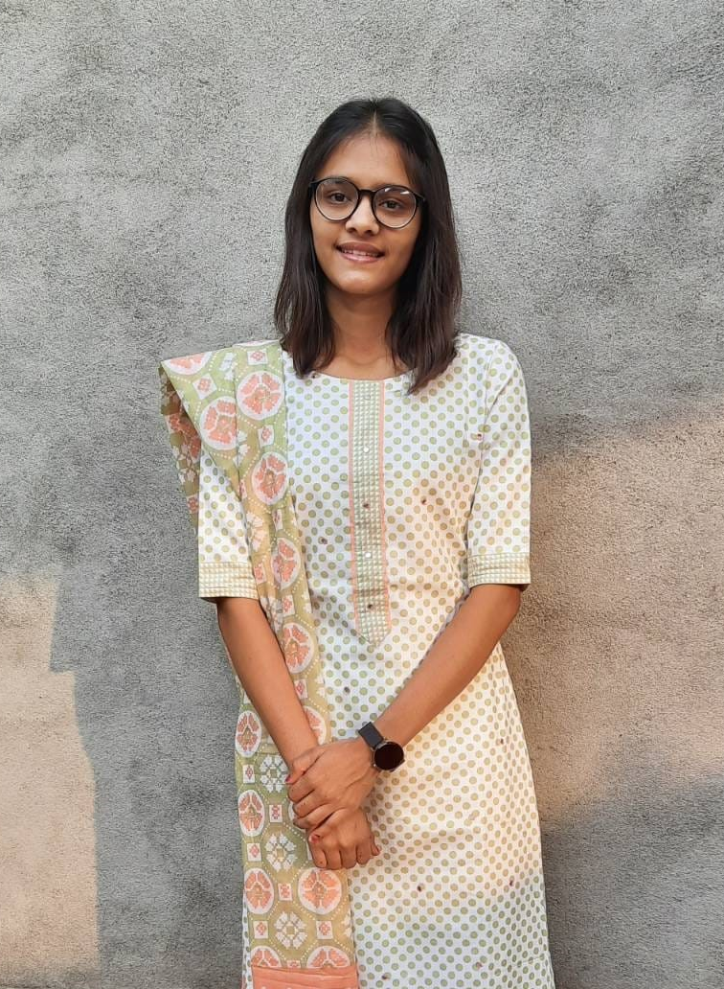
Personal Information Overview
Name : Ankita Solanki
Current Status :
Pursuing a back-end development courses
working as a teacher in personal and own coaching classes
Educational Background :
10th(2015)
12th(2017)
B.Com(2020)
Key Personality traits :
Strong work ethic
Continuously seeking opportunities to learn and improve skills.
Highly self-motivated with a strong sense of initiative

Slide 3
Technology Project
Project Overview
Project name : Chat Application
Platform : Node.js/Express with MongoDB and Socket.io
Project Description
Chat Application is the server-side application that powers a real-time chat platform designed for both private and group messaging.
It provides RESTful APIs for user management, message storage, and room creation, while utilizing WebSocket via Socket.io for instant communication between users.
Key Feature
Real-Time Messaging: Instant message delivery using WebSocket (Socket.io) for private and group chats.
User Authentication: Secure JWT-based authentication and role-based access control.
Message Storage: Efficient message storage with MongoDB, supporting search and pagination.

Slide 4
Building Confidence & Techniques for impromptu speeches
Regular Practice
Consistently I do my practice in lab for 3 hours then I communicate with my friends. This practice helps me to get more confidence and improve my knowledge.
Feedback
According to my work institute faculties give me a feedback related to language, speech, task and assignment. From feedbacks I can know my performance so I can push my self and improve.
Achievable Goal
My short term goal is to complete my course with good skills so that I can get a good job and solve a real world problem in company to improve more.
Positive Mindset
My only positive mindset is consistency beats everything. Continuously learning new skill will give me a higher stages.

Slide 5
Techniques for successful Impromptu Speeches
Breathe & Start Simple: Take a moment, then jump into your main point. Keep it clear and concise.
Tell a Story (PREP): Use the PREP method: Point, Reason, Example (story or anecdote), Point (reiterate your main idea).
Conversational & Valuable: Speak naturally and offer the audience something worthwhile.
Short & Strong: Get your point across quickly and leave a lasting impression.
Confidence is Key: Project composure and enthusiasm, even if nervous. Believe in yourself!
PREP methods
Point
Reason
Example
point

Slide 6
IT Policies
Keep data safe: I always keep my data safe with strong password, fingerprint and face lock. I never share my OTP with others and also keep my private data hide.
Gard your work: I Regularly back up my all data and never share any information.
Use software legally: I Always use licensed software and avoid downloading duplicate copies. I Regularly update my software to benefit from security patches and avoid potential issues.
Work remotely securely: I work in my closed room so my family member and other person can not see anything. If I am not working and not near to laptop then my laptop automatically get locked so other people can not use.

